Slide 1

KHATRA ADIBASI MAHAVIDYALAYA
E-CONTENT
DEPARTMENT OF EDUCATION
SEMESTER-III (PROGRAMME)
SESSION: 2020-2021
SUBJECT: EDUCATION
COURSE : EDUCATIONAL PSYCHOLOGY
COURSE CODE: AP/EDN/301/C-1C
TOPIC: THEORY OF THORNDIKE’S
NAME OF THE TEACHER: AKINCHAN PAL

Slide 2
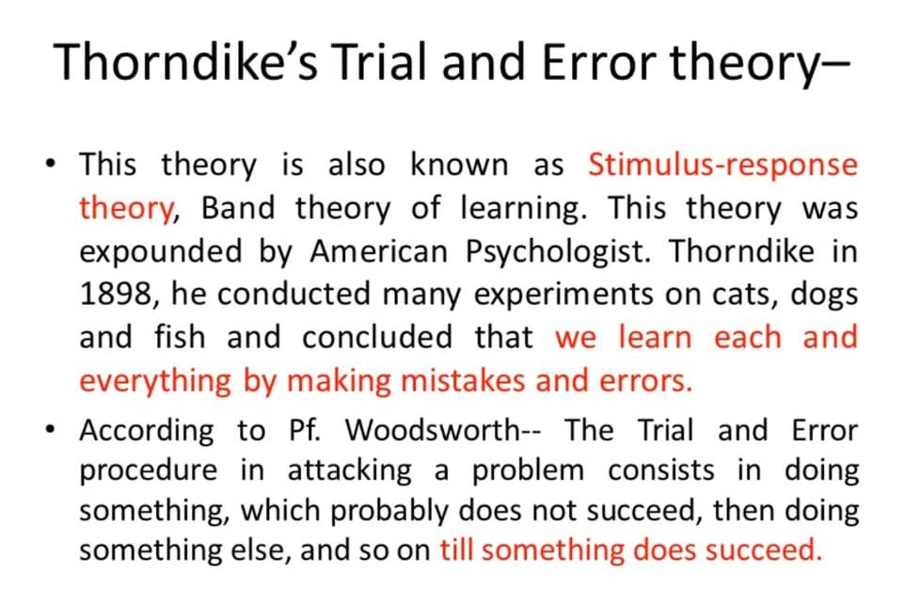

Slide 3
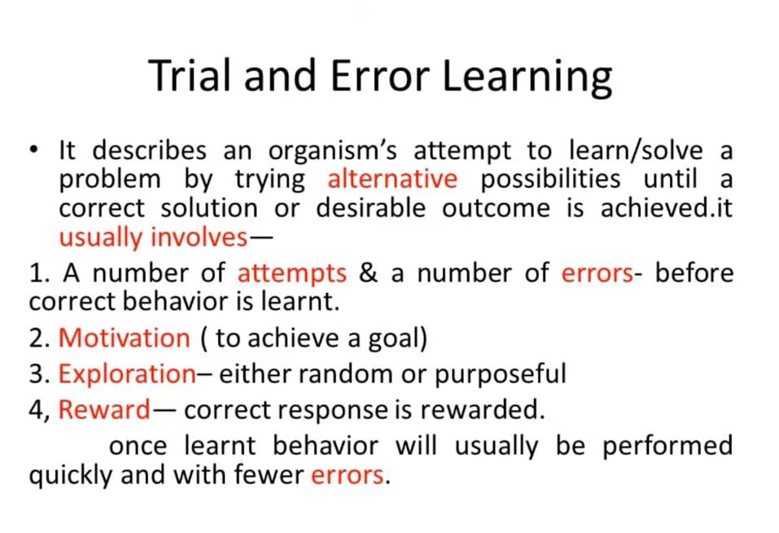

Slide 4
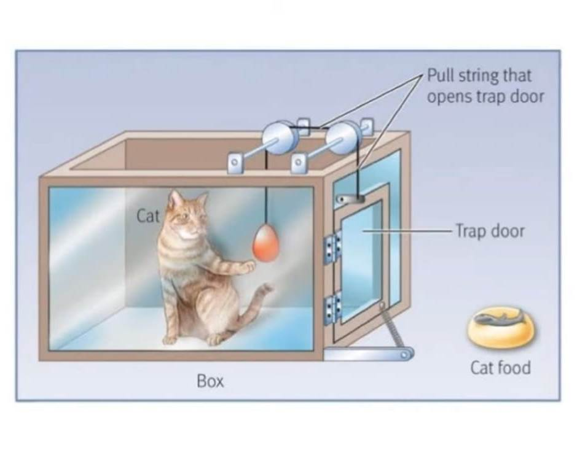
Trial and error

Slide 5
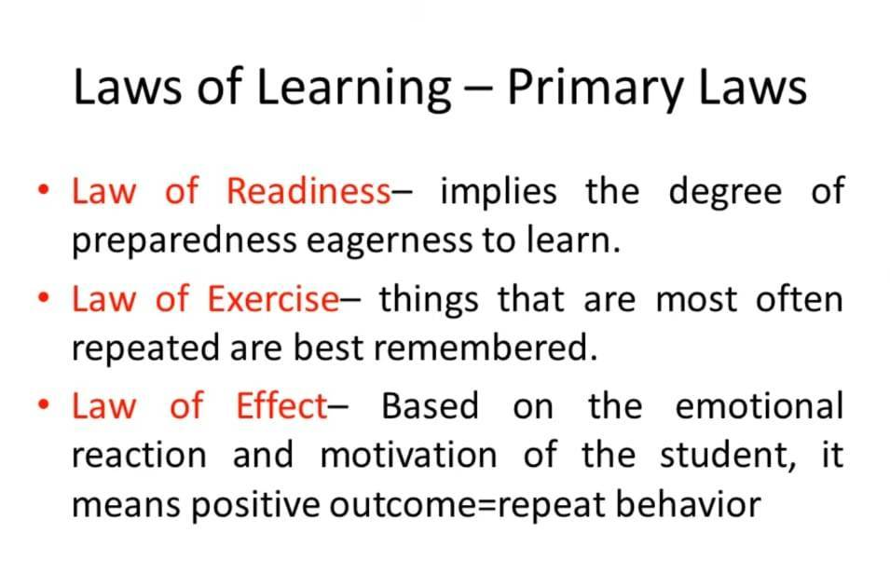

Slide 6
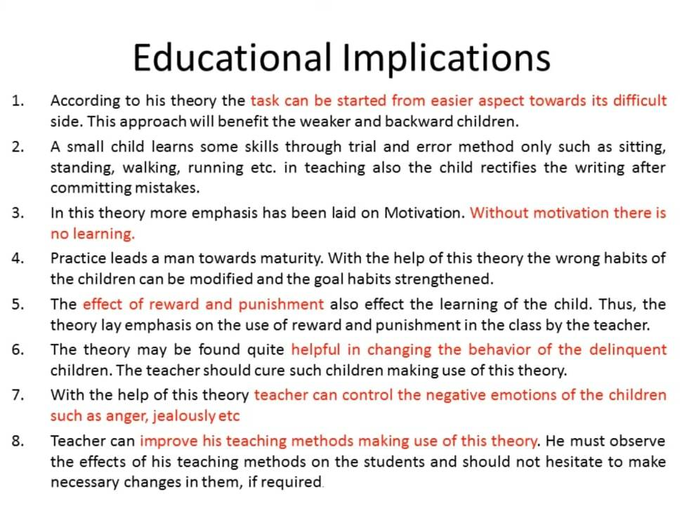

Slide 7
THANK YOU

